Slide 1
Boolean Algebra
LO: To understand the rules of Boolean algebra and De Morgan’s Law
Prep Check
Questions from Logic Gates Lesson C
Homework from Logic Gates Lesson C

Slide 2
Boolean Algebra
LO: To understand the rules of Boolean algebra and De Morgan’s Law
Specification Point
Be familiar with the use of Boolean identities and De Morgan’s laws to manipulate and simplify Boolean expressions.

Slide 3
Boolean Algebra
LO: To understand the rules of Boolean algebra and De Morgan’s Law
Simplifying Boolean Expressions
When using Boolean expressions it is good practice to reduce the expression into its simplest form.
As Boolean algebra is used to create logic gates, simplifying the expressions also simplifies the actual circuit that will be built.
An expression may be made up of many variables, usually referenced as letters (A,B,C, etc.) each of which can produce a result of 0 or 1.
This can lead to the creation of complex Boolean expressions.
Therefore rules have been developed as a method of simplifying expressions.

Slide 4
Boolean Algebra
LO: To understand the rules of Boolean algebra and De Morgan’s Law
Simplifying Boolean Expressions - Rules
A.B = B.A | The order in which two variables are ANDed makes no difference
A+B = B+A | The order in which two variables are ORed makes no difference
A.0 = 0 | A variable ANDed with 0 equals 0
A+1 = 1 | A variable ORed with 1 equals 1
A+0 = A | A variable ORed with 0 equals the variable
A.1 = A | A variable ANDed with 1 equals the variable
A.A = A | A variable ANDed with itself equals the variable
A+A = A | A variable ORed with itself equals the variable
A.Ā = 0 | A variable ANDed with its inverse equals 0

Slide 5
Boolean Algebra
LO: To understand the rules of Boolean algebra and De Morgan’s Law
Task
Draw truth tables to demonstrate that each of the rules on the previous slide are correct e.g.
A.0 = 0 A.1 = A
A | 0 | X
0 | 0 | 0
1 | 0 | 0
A | 1 | X
0 | 1 | 0
1 | 1 | 1

Slide 6
Boolean Algebra
LO: To understand the rules of Boolean algebra and De Morgan’s Law
Simplifying Boolean Expressions – More Rules
A+ Ā = 1 | A variable ORed with its inverse equals 1
Ā = A | A variable that is double inversed equals the variable
(A.B).C = A.(B.C) | It makes no difference how the variable are grouped together when ANDed
(A+B)+C = A+(B+C) | It makes no difference how the variable are grouped together when ORed
A.(B + C) = A.B + A.C | The expression can be distributed or factored out meaning that variables can be moved in and out of brackets either side of the expression. In English this expression would be A AND (B OR C) = (A AND B) OR (A AND C ).

Slide 7
Boolean Algebra
LO: To understand the rules of Boolean algebra and De Morgan’s Law
De Morgan’s Law
De Morgan’s Law is a another way of simplifying Boolean statements.
Invert all the variables, changing ANDs to OR and ORs to ANDs.
Then invert the whole expression.
One application is to simplify statements so that only NAND or NOR gates are used when building circuits.
The basic principles are:
Rule 1: NOT (A AND B) is the same as (NOT A) OR (NOT B)
Rule 2: NOT (A OR B) is the same as (NOT A) AND (NOT B)

Slide 8
Boolean Algebra
LO: To understand the rules of Boolean algebra and De Morgan’s Law
De Morgan’s Law
A + B = A . B
A . B = A + B

Slide 9
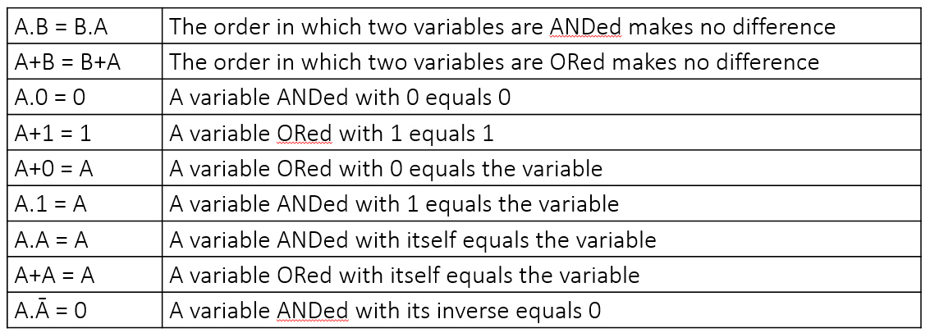
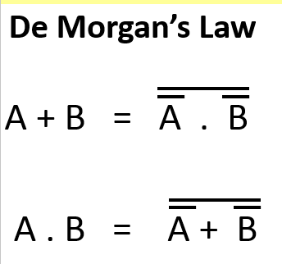
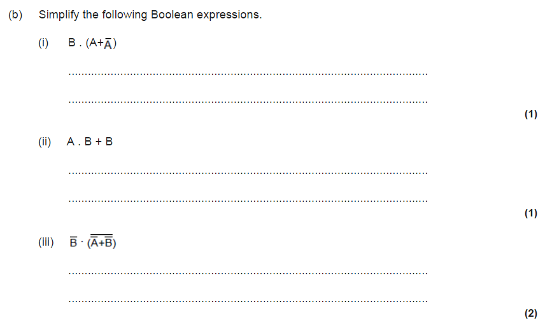
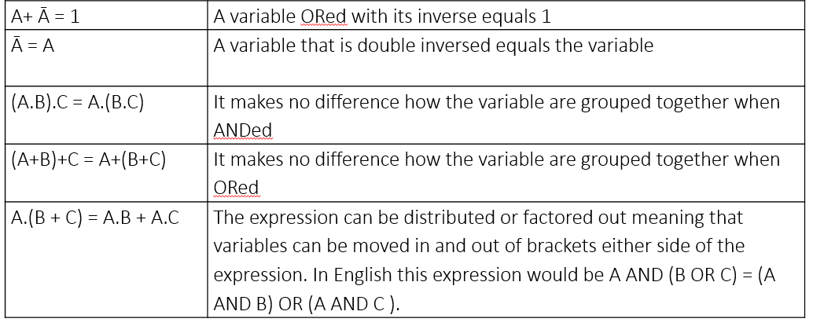
Boolean Algebra
LO: To understand the rules of Boolean algebra and De Morgan’s Law
Some examples
B . 1
B
(A.B) + B
B
B . (A.B) → B . A . B → A . 0
0

Slide 10
Boolean Algebra
LO: To understand the rules of Boolean algebra and De Morgan’s Law
Some examples
A | B | (A+A) | B. (A+A)
0 | 0 | 1 | 0
0 | 1 | 1 | 1
1 | 0 | 1 | 0
1 | 1 | 1 | 1
B . 1
B
(A.B) + B
B
B . (A.B)
0

Slide 11
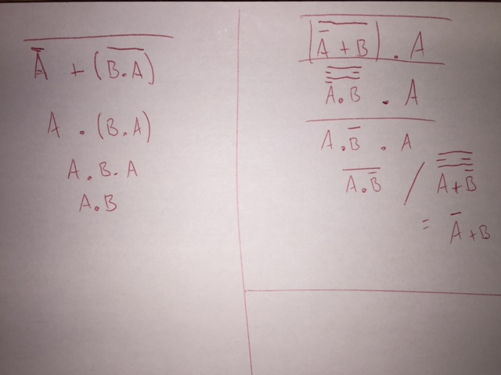
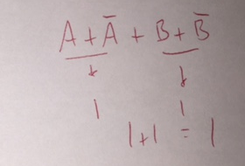
Boolean Algebra
LO: To understand the rules of Boolean algebra and De Morgan’s Law
Tasks
A + (B . A)
(A + B) . A
A + B + A + B

Slide 12
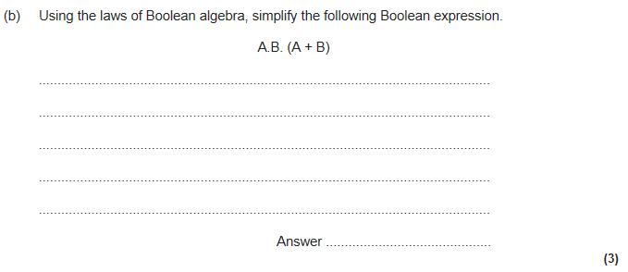
Boolean Algebra
LO: To understand the rules of Boolean algebra and De Morgan’s Law
Exam Questions

Slide 13
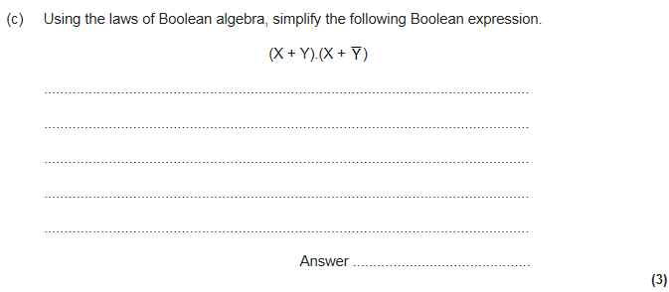
Boolean Algebra
LO: To understand the rules of Boolean algebra and De Morgan’s Law
Exam Questions

Slide 14
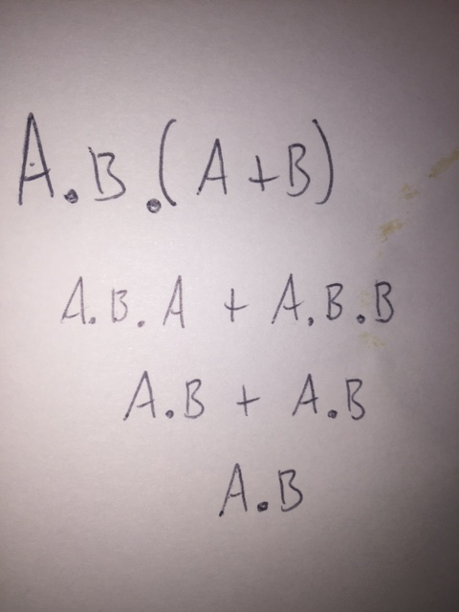
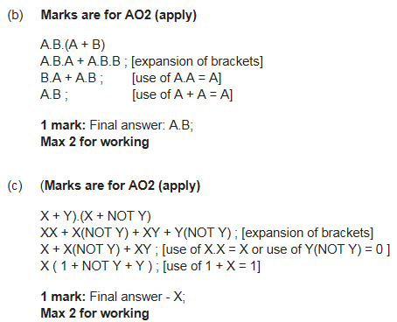
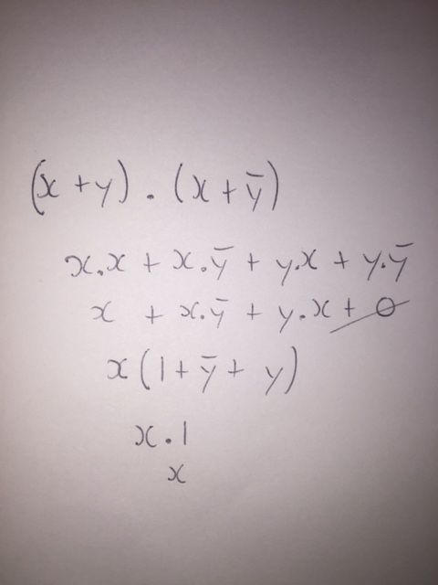
Boolean Algebra
LO: To understand the rules of Boolean algebra and De Morgan’s Law
Exam Question

Slide 15
Boolean Algebra
LO: To understand the rules of Boolean algebra and De Morgan’s Law
Homework
Complete the Boolean Algebra HW task on Copia.

Slide 16


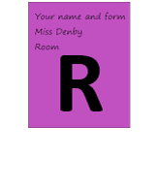












Key words:
Noted clearly
Topic specific vocabulary wherever necessary
Icon for extension activity if appropriate
Icon same colour as dept ex book
You might want to develop subject specific icons

